Slide 1

Hidden Markov Models

Slide 2
HMM Applications
Malware detection
Stock prediction
Bioinformatics
Speech recognition (ex, Siri)
Cryptanalysis
Machine translation
Handwriting recognition
Time series analysis
and many more…

Slide 3
A hidden Markov model (HMM) includes a Markov process that is “hidden”
We cannot directly observe the state of the process
But we do have access to a series of observations that are probabilistically related to the underlying Markov model

Slide 4
Probabilities
The notation “|” denotes “given” information, so that P(B|A) is read as “the probability of B, given A”
For any two events A and B, we have:
P(A and B) = P(A)P(B|A)
For example, suppose that we draw two cards without replacement from a standard 52-card deck
Let A = {1st card is ace} and B = {2nd card is ace}. Then:
P(A and B) = P(A)P(B|A) = 4/52 * 3/51 = 12/2652 = 1/221
In this example, P(B) depends on what happens in the first event , so we say that A and B are dependent events
Notes:
Note that 4/52 is ~0.077, while 3/51 is ~0.059, so it became less likely because you have 1 less ace in the deck

Slide 5
Probabilities
On the other hand, suppose we flip a fair coin twice
The probability that the second flip comes up heads is ½
Regardless of the outcome of the first coin flip, so these events are independent
For dependent events, the “given” information is relevant when determining the sample space.
Consequently, in such cases we can view the information to the right of the “given” sign as defining the space over which probabilities will be compute

Slide 6
Probabilities
Note that P(B|A) would define a First-order Markov Model
We can also have Second-order Markov Model: P(C|A,B)
And Third-order Markov Model: P(D|A,B,C)
And so on…

Slide 7

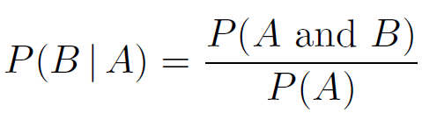
We rewrite:
As:
This expression can be viewed as the definition of conditional probability

Slide 8

We can see it as an intersection
This will be useful later…

Slide 9
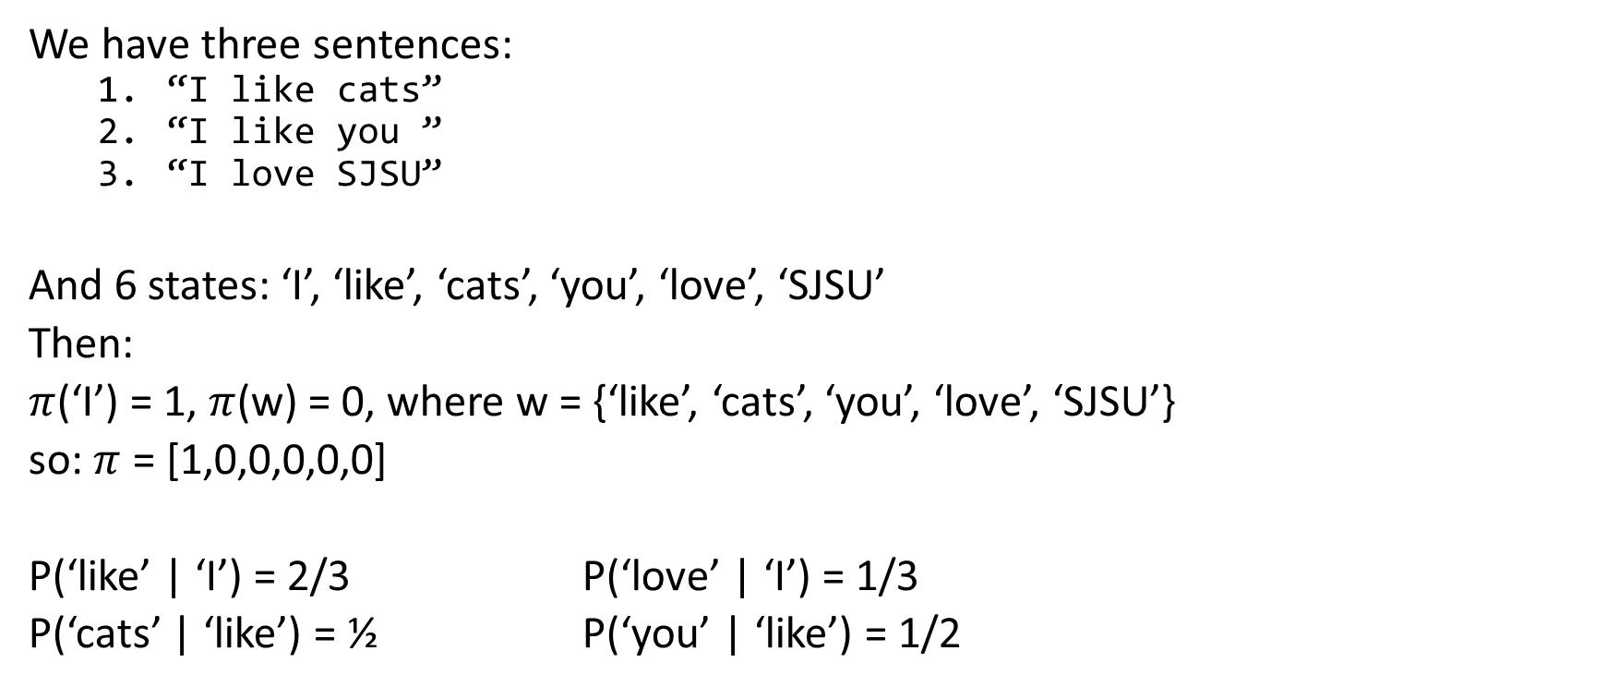
Markov Process example
We have three sentences:
“I like cats”
“I like you ”
“I love SJSU”
And 6 states: ‘I’, ‘like’, ‘cats’, ‘you’, ‘love’, ‘SJSU’
Then:
$π$(‘I’) = 1, $π$(w) = 0, where w = {‘like’, ‘cats’, ‘you’, ‘love’, ‘SJSU’}
so: $π$ = [1,0,0,0,0,0]
P(‘like’ | ‘I’) = 2/3 P(‘love’ | ‘I’) = 1/3
P(‘cats’ | ‘like’) = ½ P(‘you’ | ‘like’) = 1/2

Slide 10
HMM Example
Suppose we want to determine the average annual temperature at a particular location on Earth over a series of years in the distant past
To simplify the problem, we only consider “hot” and “cold” for the average annual temperature (binary)
Modern evidence indicates that:
The probability of a hot year followed by another hot year is 0.7
The probability that a cold year is followed by another cold year is 0.6
We’ll assume that these probabilities also held in the distant past

Slide 11
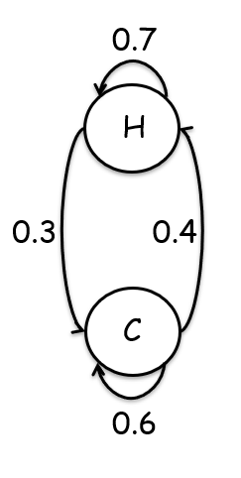
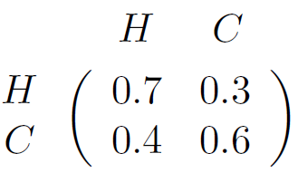
HMM Example
This information can be summarized as:
The transition from one state to the next is a Markov process
Since the next state depends only on the current state and the fixed probabilities given in the matrix
Notes:
On the right we see the respective Markov Chain
A Markov process where the current state only depends on the previous state is said to be of order one.
In a Markov process of order n, the current state depends on the n consecutive preceding states. In any case, the “memory” is finite.

Slide 12

HMM Example
Next, suppose that current research indicates a correlation between the size of tree growth rings and temperature.
For simplicity, we only consider three different tree ring sizes, small, medium, and large, denoted S, M and L

Slide 13
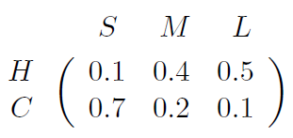
HMM Example
Based on currently available evidence, the probabilistic relationship between annual temperature and tree ring sizes is given by:

Slide 14
HMM Example
Although we can’t observe the state (temperature) in the past, we can observe the size of tree rings
Since the underlying states are hidden, this type of system is known as a hidden Markov model (HMM)

Slide 15

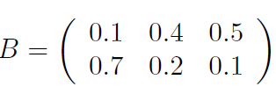
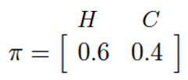

HMM Model
Transition matrix:
Observation matrix:
Initial state distribution:
The matrices are row stochastic (discrete probability distribution)

Slide 16
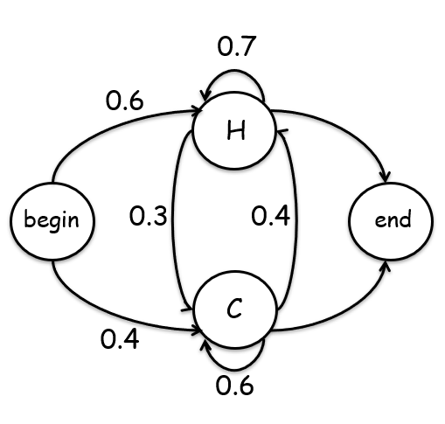
HMM Model
The initial distribution matrix indicates the chance that we start in the H state is 0.6 and the chance that we start in the C state is 0.4
Notes:
On the left a Markov chain with begin/end states

Slide 17

HMM Example
Now, suppose that we consider a particular four-year period of interest from the distant past
For this particular four-year period, we observe the series of tree ring sizes S, M, S, L. Letting:
0 represent S
1 represent M
2 represent L

Slide 18
HMM Example
We might want to determine the most likely state sequence of the Markov process given these observations
That is, we might want to know the most likely average annual temperatures over this four-year period of interest
But what “most likely” means?
We could define “most likely” as the state sequence with the highest probability from among all possible state sequences of length 4
Dynamic programming (DP) can be used to efficiently solve this problem
Or, “most likely” could be the state sequence that maximizes the expected number of correct states
An HMM can be used to find the most likely hidden state sequence in this latter sense

Slide 19
HMM Example
It’s important to realize that the DP and HMM solutions to this problem are not necessarily the same
For example, the DP solution must, by definition, include valid state transitions, while this is not the case for the HMM
And even if all state transitions are valid, the HMM solution can still differ from the DP solution, as we’ll illustrate in an example

Slide 20
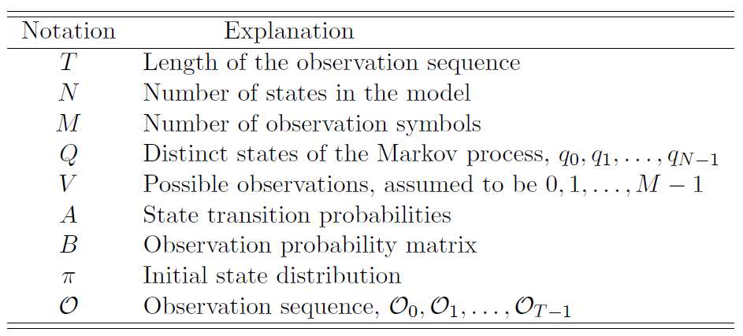
The Notation

Slide 21


HMM Notation
Note that for simplicity, observations taken from V = {0,1,…,M-1}
That is:
The transition matrix A = {a_{ij}} is N x N, where
The observation matrix B = {b_{j}(k)} is N x M, where
V = possible observations
N = # of states
M = # of observation symbols
q = state in the Markov process
$𝓞$ = observation sequence
T = length of $𝒪$

Slide 22

Consider our temperature example…
What are the observations?
V = {0,1,2}, corresponding to S,M,L
What are states of Markov process?
Q = {H,C}
What are A,B, π, and T?
A,B, π on previous slides
T is number of tree rings
measured
What are N and M?
N = 2 and M = 3
V = possible observations
M = # observation symbols
N = # of states
M = # of observation symbols
q = state in the Markov process
$𝓞$ = observation sequence
T = length of $𝒪$

Slide 23
Generic HMM
Generic view of HMM
HMM defined by A,B, and π
We denote HMM “model” as λ = (A,B,π)

Slide 24
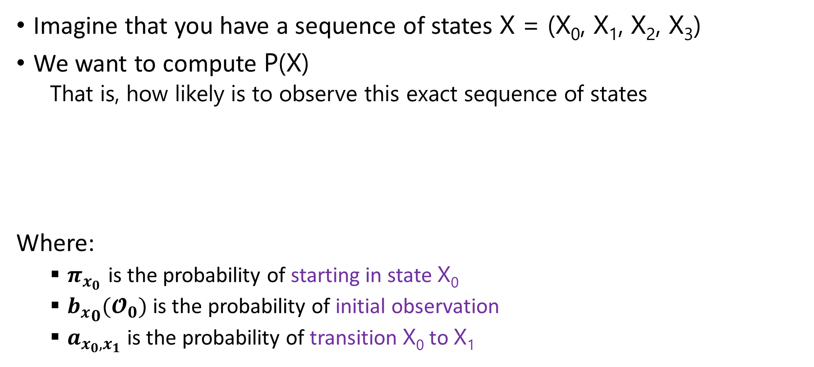
HMM Example
Imagine that you have a sequence of states X = (X₀, X₁, X₂, X₃)
We want to compute P(X)
That is, how likely is to observe this exact sequence of states
Where:
$π_{x_{0}}$ is the probability of starting in state X₀
${b_{x}}_{0}(𝓞_{0})$ is the probability of initial observation
$a_{x_{0},x_{1}}$ is the probability of transition X₀ to X₁

Slide 25
HMM Example
Let’s Assume that we observe: ( 0, 1, 0, 2) or (S, M, S, L)
What is probability of: H H C C ?
Initial state distribution
Transition matrix
Observation matrix

Slide 26
HMM Example
Let’s Assume that we observe: ( 0, 1, 0, 2) or (S, M, S, L)
What is probability of: H H C C ?
Initial state distribution
Transition matrix A
Observation matrix B

Slide 27
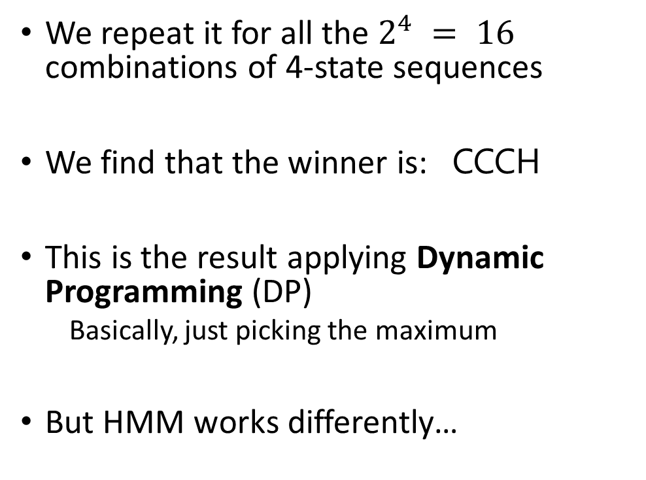
HMM Example
We repeat it for all the $2^{4} = 16$ combinations of 4-state sequences
We find that the winner is: CCCH
This is the result applying Dynamic Programming (DP)
Basically, just picking the maximum
But HMM works differently…
Notes:
Remember that this table has been computed from the sequence (0,1,0,2). Different sequences would compute different values.

Slide 28
HMM Example
To find the optimal state sequence in the HMM sense, we choose the most probable symbol at each position
So, we sum the normalized probabilities that have an H in the first position
The sum is equal to:
0.188182
SUM
0.188181

Slide 29
HMM Example
We repeat the same for C in the first position
The normalized sum in this case is:
0.811818
SUM
0.188181
SUM
0.811818

Slide 30
HMM Example
We continue, now with all the cases where H is in second position:
0.519576
And C in second position:
0.480424
And so on…
SUM
0.519576
SUM
0.480424

Slide 31
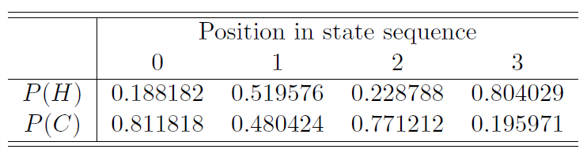
HMM Example
We continue with all the other positions, until we built a table like this one:
Finally, for each position, we select the most likely symbol. That is, our sequence (in HMM terms) would be:
CHCH
Notes:
Note that in this example, the optimal DP sequence differs from the optimal HMM sequence

Slide 32
HMM Example
HMM solution gives us CHCH
While DP solution is CCCH
Which solution is better?
Neither solution is better
Just using different definitions of “best”
Notes:
Note that in this example, the sequence of states CHCH is possible, but still the two results differ

Slide 33
HMM Paradox?
HMM maximizes expected number of correct states
Whereas DP chooses “best” overall path
Possible for HMM to choose a “path” that is impossible
Could be a transition probability of 0
We cannot get impossible path with DP
Is this a flaw with HMM?
No, it’s a feature

Slide 34
The Three Problems

Slide 35
The Three Problems
HMMs are used to solve 3 problems:
Problem 1: Given a model λ = (A,B,π) and observation sequence O, find P(O|λ)
We score an observation sequence to see how well it fits a given model
Problem 2: Given λ = (A,B,π) and O, find an optimal state sequence (in HMM sense)
Uncover hidden part (like previous example)
Problem 3: Given O, N (# states), and M (# of symbols), find the model λ that maximizes probability of O
That is, train a model to fit observations

Slide 36
HMMs in Practice
Often, we use HMMs as follows:
We compute an observation sequence
We also assume that (hidden) Markov process exists
We train a model based on observations
That is, we solve Problem 3
“Best” N (# states) can be found by trial and error
Then given a (usually different, but ‘compatible’) sequence of observations, we score it versus the model we trained
This is Problem 1 ⎯ high score implies similar to training data, low score says it’s not similar
Notes:
In many applications in NLP, the solution to Problem 2 is the crucial thing.

Slide 37
HMMs in Practice
Previous slide gives sense in which HMM is a “machine learning” technique
To train model, we do not need to specify anything except the parameter N
“Best” N often found by trial and error (like a “hyperparameter”)
So, we don’t need to think too much
Just train HMM and then use it
Practical, since we have efficient algorithms for training HMM and scoring

Slide 38
The Three Solutions
We give detailed solutions to 3 problems
However, we must find efficient solutions
The 3 problems:
Problem 1: Score an observation sequence versus a given model
Problem 2: Given a model, “uncover” most likely hidden part
Problem 3: Given an observation sequence, train a model
Recall that we considered example for 2 and 1 in the previous slides
But direct solutions are soooooo inefficient

Slide 39
Solution 1
Score observations versus a given model
Given model λ = (A,B,π) and observation sequence O=(O₀,O₁,…,O_{T-1}), find P(O|λ)
Denote hidden states as: X = (X₀, X₁, . . . , X_{T-1})
And from definition of A and π: P(X|λ) = π_{X0} a_{X0,X1} a_{X1,X2} … a_{XT-2,XT-1}
Then from definition of B: P(O|X,λ) = b_{X0}(O₀) b_{X1}(O₁) … b_{XT-1}(O_{T-1})
A =
B =

Slide 40

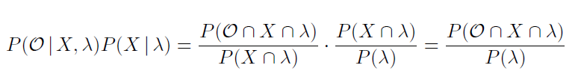

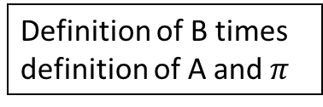
Remember:
Since:
And:
We have:
The problem that we want to solve over all the possible X combinations
Definition of B times definition of A and $π$

Slide 41
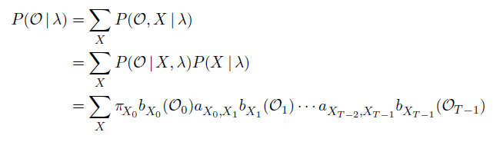


Solution 1
The probability $P\left(𝒪 | λ\right)$ is given summing together all possible state sequence probabilities:
The direct computation here is generally infeasible
Since the number of multiplications is about $2{TN}^{T}$
Where T is typically large and N ≥ 2
Definition of B times definition of A and $π$
Notes:
Note that this is a SUM over all the possible X combinations

Slide 42

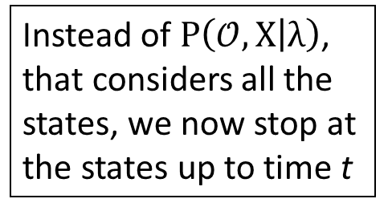
Forward Algorithm
Instead of $P\left(𝒪,X | λ\right)$, that considers all the states, we now stop at the states up to time t
Instead, we can use forward algorithm
Also known as: “alpha pass”
For t = 0,1,…,T-1 and i=0,1,…,N-1, let:
This is probability of partial observation sequence up to time t, where the underlying Markov process is in state q_{i} at time t
Can be computed recursively and efficiently

Slide 43
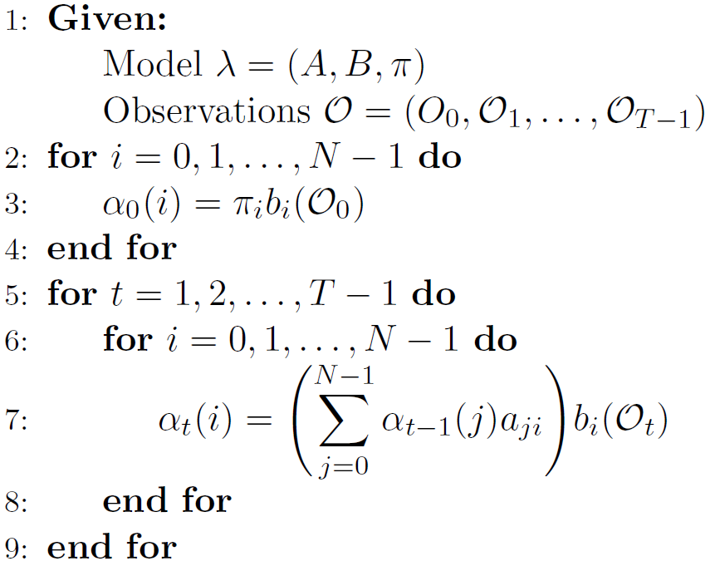
Forward Algorithm
This requires only N²T multiplications

Slide 44
Forward Algorithm
This is also called: Initialization Step
This instead is called: Induction Step
This requires only N²T multiplications
Notes:
Note that, when computing the last alpha value, it is also called “Termination Step”. All the other alpha values computed (except the first ones denoted with $α_{0}(i)$) are part of the Induction Step

Slide 45
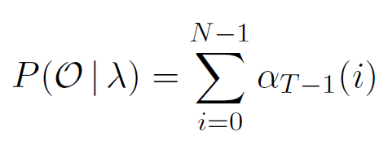

Forward Algorithm
From the formula:
It follows that:
Hence, the forward algorithm gives us an efficient way to compute a score for a given sequence O, relative to a given model $λ$

Slide 46
Solution 2
Given a model, find hidden states
Given λ = (A,B,π) and O, find an optimal state sequence
Recall that optimal means “maximize expected number of correct states”
In contrast, DP finds best scoring path
For temp/tree ring example, we solved this
But hopelessly inefficient approach
A better way: backward algorithm
Also known as: “beta pass”

Slide 47
Backward Algorithm
For t = 0,1,…,T-1 and i = 0,1,…,N-1, let:
This is probability of partial observation sequence starting from time t, where the underlying Markov process is in state q_{i} at time t
Analogous to the forward algorithm
As with forward algorithm, this can be computed recursively and efficiently
Notes:
This is analogous to the -pass discussed above, except that we start at the end and work back toward the beginning

Slide 48
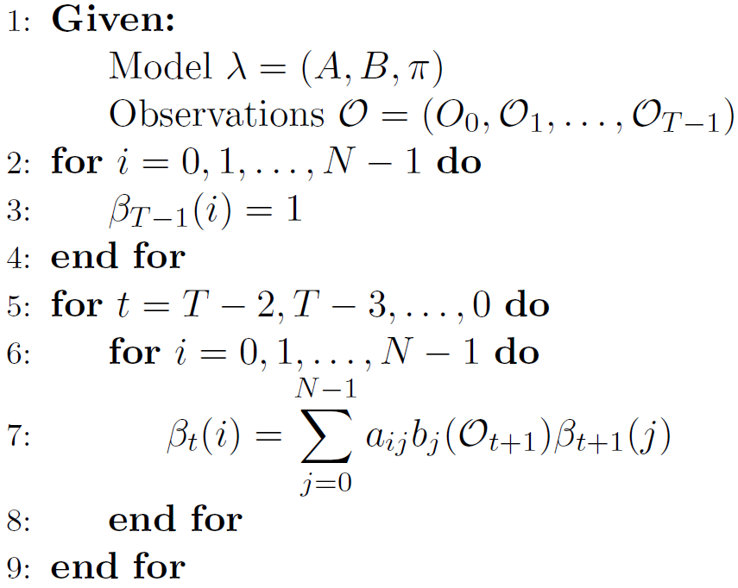
Backward Algorithm
Note: it goes backward now

Slide 49

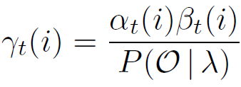
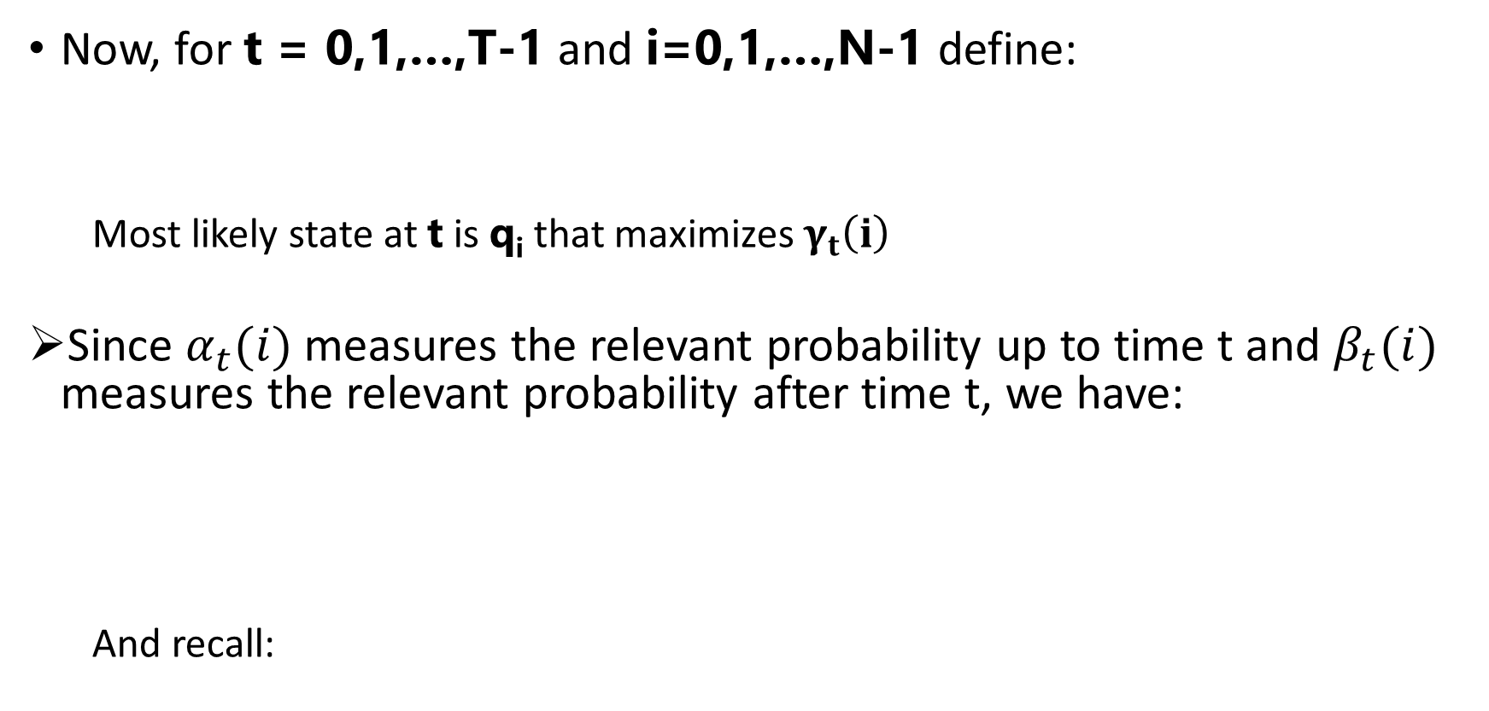
Solution 2
Now, for t = 0,1,…,T-1 and i=0,1,…,N-1 define:
Most likely state at t is q_{i} that maximizes $γ_{t}\left(i\right)$
Since $α_{t}(i)$ measures the relevant probability up to time t and $β_{t}(i)$ measures the relevant probability after time t, we have:
And recall:

Slide 50
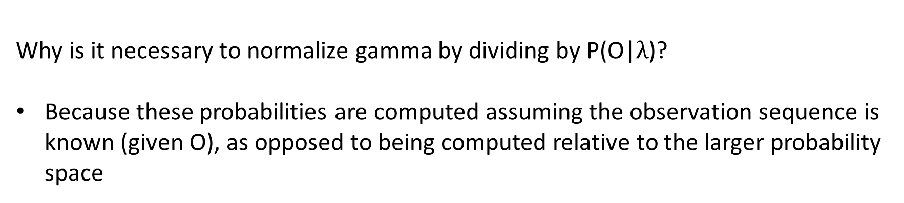
Solution 2
Why is it necessary to normalize gamma by dividing by P(O|$λ$)?
Because these probabilities are computed assuming the observation sequence is known (given O), as opposed to being computed relative to the larger probability space

Slide 51

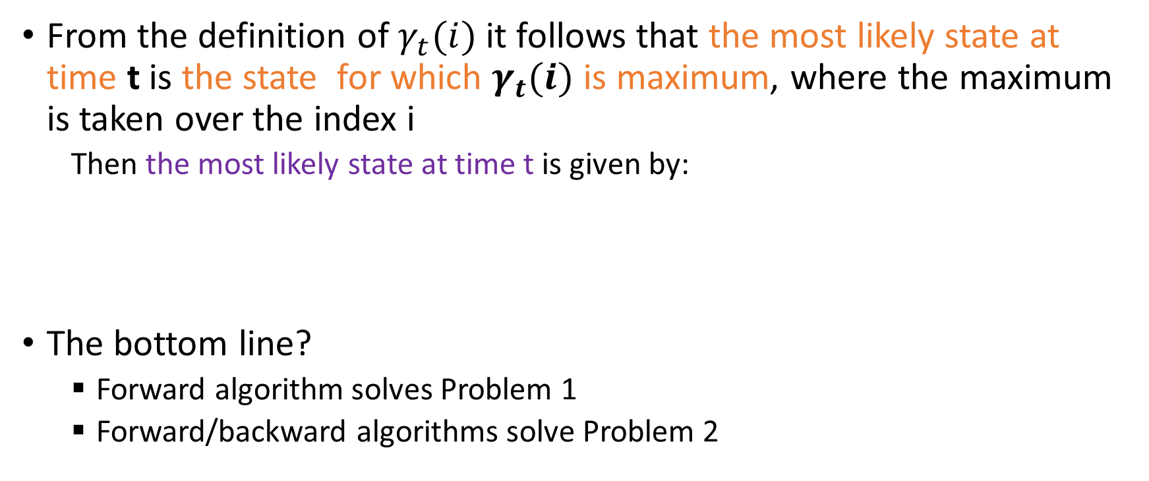
Solution 2
From the definition of $γ_{t}(i)$ it follows that the most likely state at time t is the state for which $γ_{t}(i)$ is maximum, where the maximum is taken over the index i
Then the most likely state at time t is given by:
The bottom line?
Forward algorithm solves Problem 1
Forward/backward algorithms solve Problem 2

Slide 52
Solution 3
Train a model: Given O, N, and M, find λ that maximizes probability of O
We’ll iteratively adjust λ = (A,B,π) to better fit the given observations O
The size of matrices are fixed (N and M)
But elements of matrices can change
It is nice that this works…
…and amazing that it’s efficient!

Slide 53

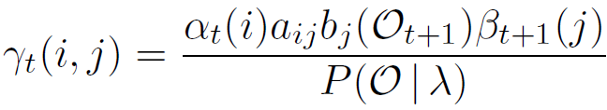
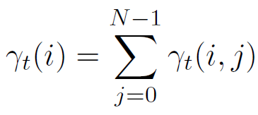
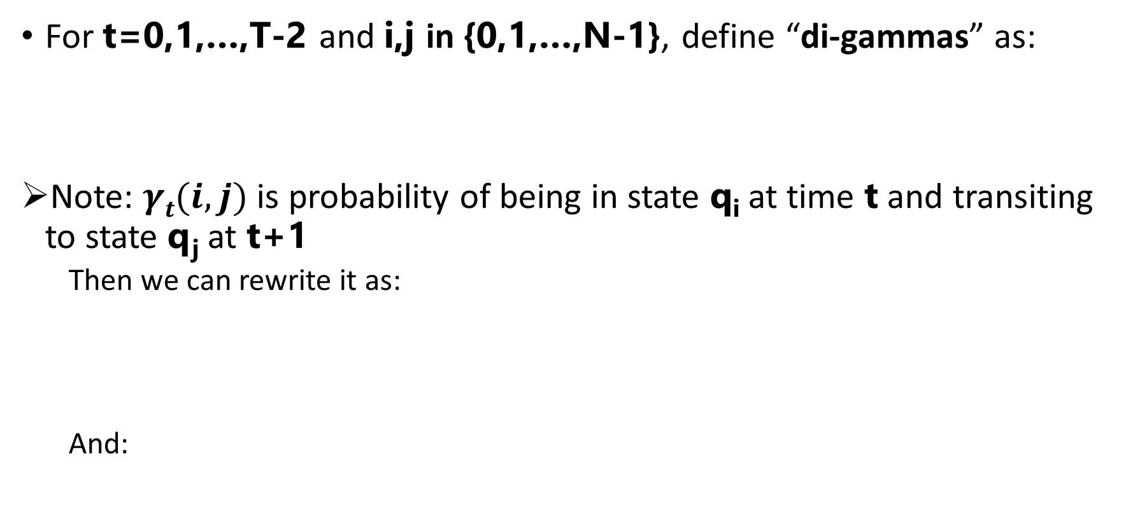
Solution 3
For t=0,1,…,T-2 and i,j in {0,1,…,N-1}, define “di-gammas” as:
Note: $γt(i,j)$ is probability of being in state q_{i} at time t and transiting to state q_{j} at t+1
Then we can rewrite it as:
And:
Notes:
Note that even in this case we divide it by P(O | lambda)

Slide 54
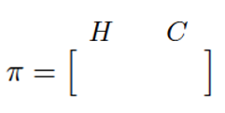
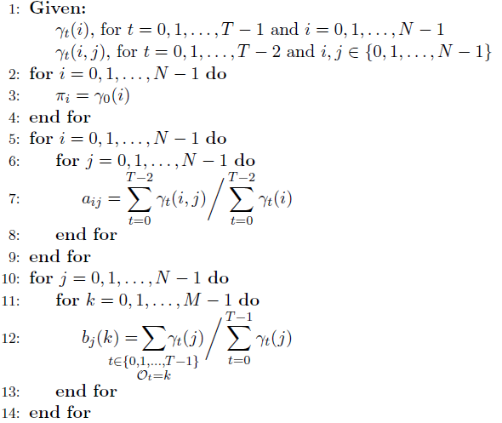
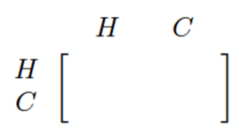
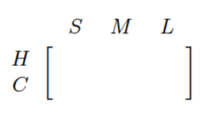
Solution 3
These two sums are very similar, but in the nominator we consider only t for which O_{t} = k and only these values are counted in the numerator
That is, per each individual symbol [0, M-1] that appears in O
Notes:
No matrices… because we are creating them!

Slide 55
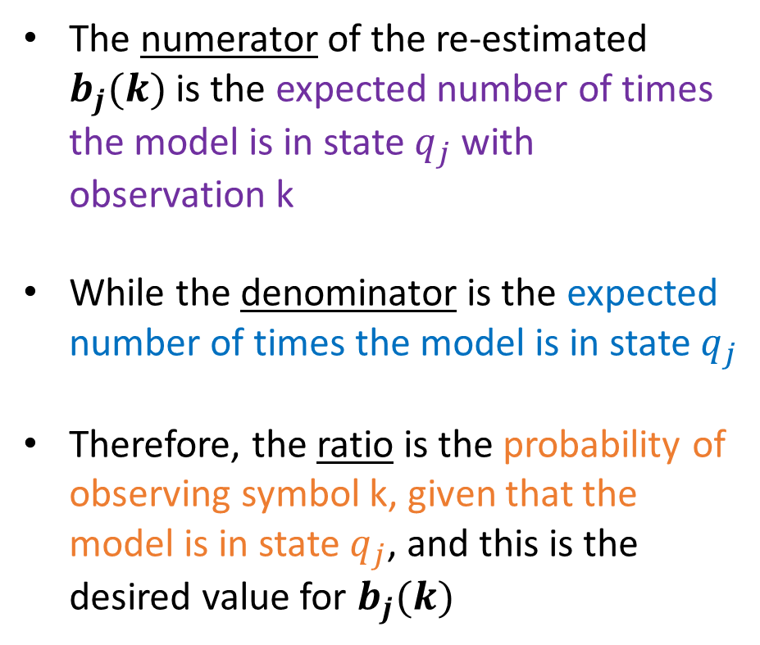
Solution 3
The numerator of the re-estimated $b_{j}(k)$ is the expected number of times the model is in state $q_{j}$ with observation k
While the denominator is the expected number of times the model is in state $q_{j}$
Therefore, the ratio is the probability of observing symbol k, given that the model is in state $q_{j}$, and this is the desired value for $b_{j}(k)$

Slide 56
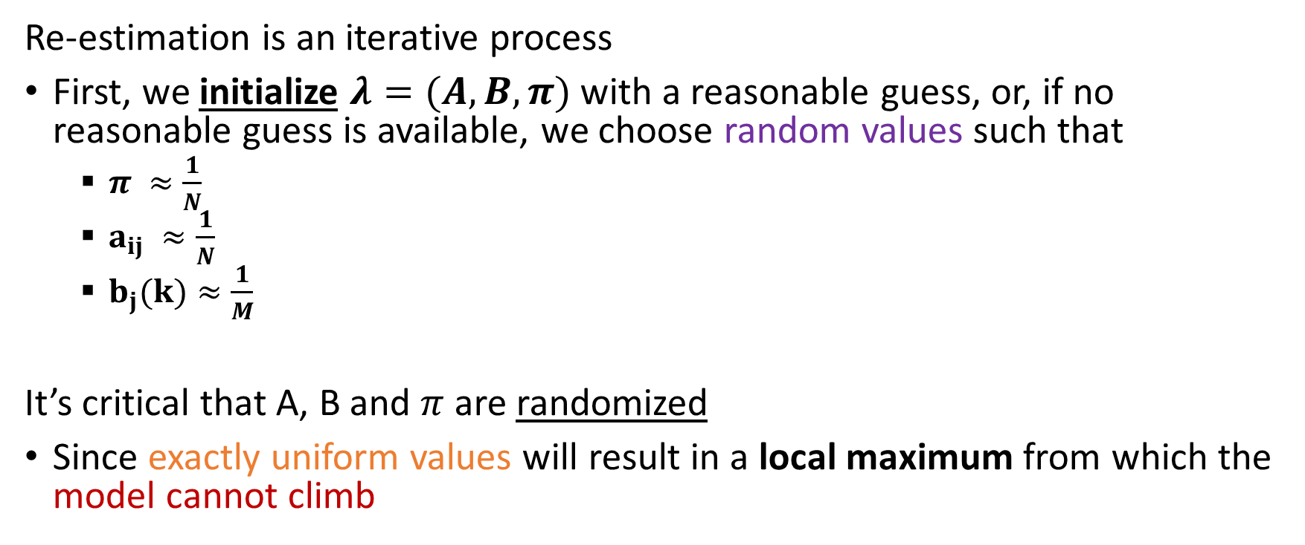
Model Re-estimation
Re-estimation is an iterative process
First, we initialize $λ=(A,B,π)$ with a reasonable guess, or, if no reasonable guess is available, we choose random values such that
$π ≈\frac{1}{N}$
$a_{ij} ≈\frac{1}{N}$
$b_{j}(k)≈\frac{1}{M}$
It’s critical that A, B and $π$ are randomized
Since exactly uniform values will result in a local maximum from which the model cannot climb
Notes:
And, as always, $π$, A and B must be row stochastic

Slide 57
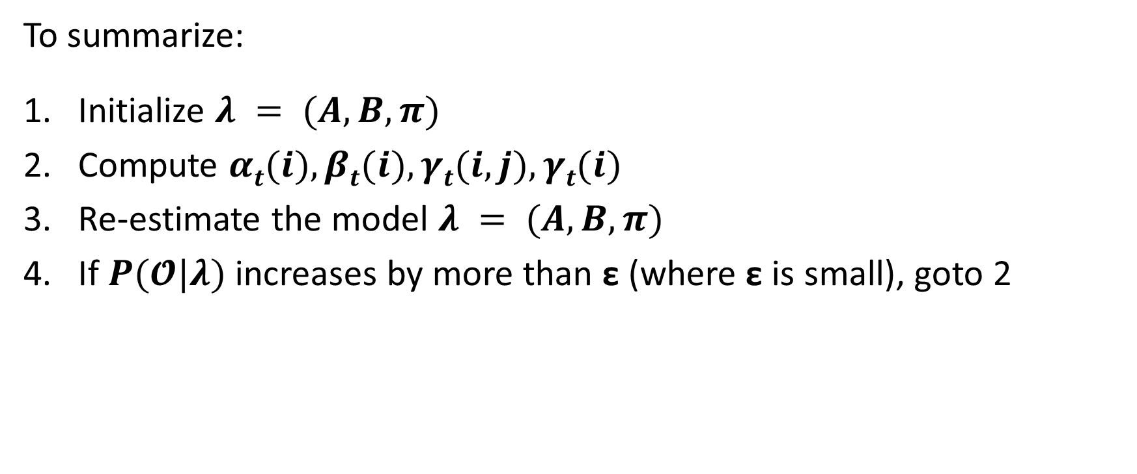
Solution 3
To summarize:
Initialize $λ = (A,B,π)$
Compute $αt(i), βt(i), γt(i,j), γt(i)$
Re-estimate the model $λ = (A,B,π)$
If $P(𝓞|λ)$increases by more than ε (where ε is small), goto 2

Slide 58
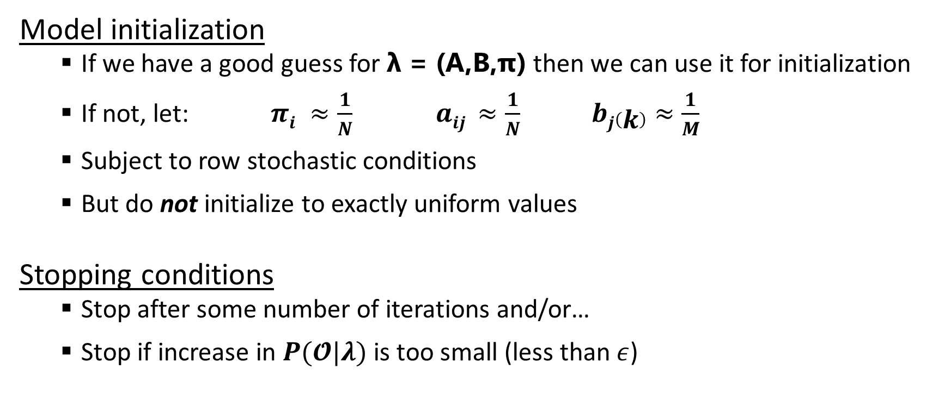
Solution 3
Model initialization
If we have a good guess for λ = (A,B,π) then we can use it for initialization
If not, let: $πi ≈\frac{1}{N}$ $aij ≈\frac{1}{N}$ $bj\left(k\right)≈\frac{1}{M}$
Subject to row stochastic conditions
But do not initialize to exactly uniform values
Stopping conditions
Stop after some number of iterations and/or…
Stop if increase in $P(𝓞|λ)$is too small (less than $ε$)

Slide 59
HMM as Discrete Hill Climb
Algorithm on previous slides shows that HMM is a “discrete hill climb”
HMM consists of discrete states X_{t}
“Climb” on the elements of the matrices
And re-estimation process improves model by modifying parameters
So, “climbs” toward improved model
This happens in a high-dimensional space

Slide 60
Dynamic Programming
Brief detour to show the close relationship between dynamic programming (DP) and HMMs
For λ = (A,B,π) it’s easy to define a dynamic program
DP is like the forward algorithm (alpha-pass) but with “sum” replaced by “max”

Slide 61
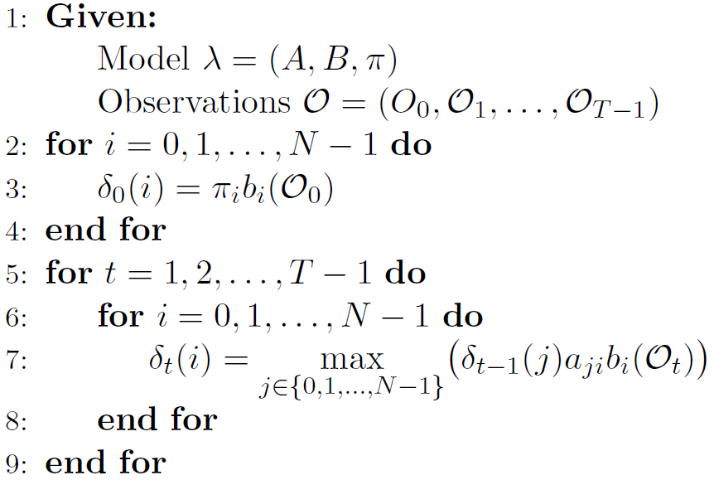

Dynamic Programming
Here we see the dynamic programming algorithm, which is also known as the Viterbi algorithm
Note that at each t, the DP computes best path for each state, up to that point
So, probability of best path is:
This max gives the highest probability, but not the best path

Slide 62
Dynamic Programming
It is important to realize that this formula only gives the optimal probability, not the corresponding path
To determine optimal path:
While computing deltas, keep track of pointers to previous state
When finished, construct optimal path by tracing back points

Slide 63


Dynamic Programming
For example, let’s consider again the temperature example
Recall that we observe (0,1,0,2)
The initial probabilities (path of length 1) are:
The probabilities of the paths of length two are given by:

Slide 64
Dynamic Programming
Probabilities for each path of length 2
Best path of length 2 ending with H is CH
Best path of length 2 ending with C is CC

Slide 65
Dynamic Program
Continuing, we compute best path ending at H and C at each step
And then we save pointers
Note that at each stage, the dynamic programming algorithm only needs to maintain the highest-scoring path ending at each state—not a list of all possible paths (this is the key to the efficiency of the algorithm)

Slide 66
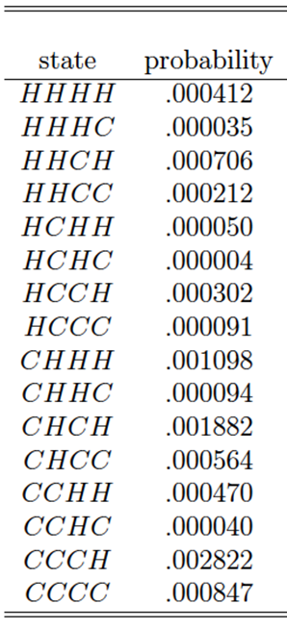
Dynamic Program
Best final score is .002822
And thanks to pointers, best path is CCCH
But what about underflow?
A serious problem in bigger cases
Notes:
Note that this agrees with the brute force calculation done ‘manually’ in the last lecture

Slide 67
Underflow Resistant DP
Common trick to prevent underflow:
Instead of multiplying probabilities…
We add logarithms of probabilities
Why does this work?
Because log(xy) = log x + log y
Adding logs does not tend to 0
Note that these logs are negative… and we must avoid 0 probabilities

Slide 68
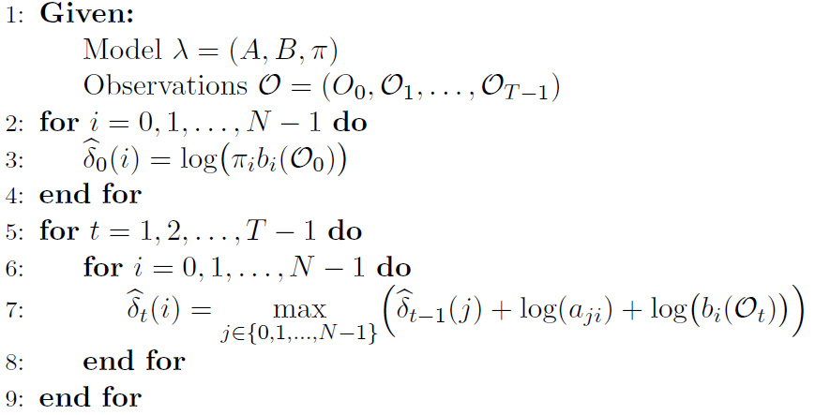

Underflow Resistant DP
Again, the optimal score is given by:

Slide 69
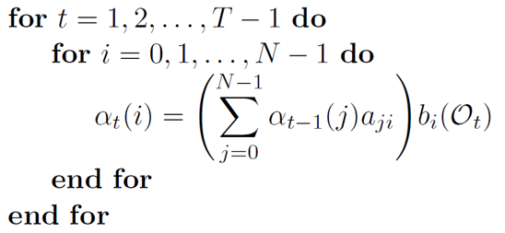

HMM Scaling
The three HMM solutions all involve products of probabilities
It’s very easy to see, for example, that $α_{t}(i)$ tends to 0 exponentially as T increases
Therefore, any attempt to implement the HMM algorithms will inevitably result in underflow
Notes:
Remember that the terms in the matrices are =<1

Slide 70
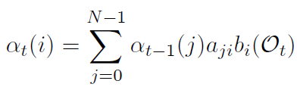
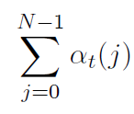
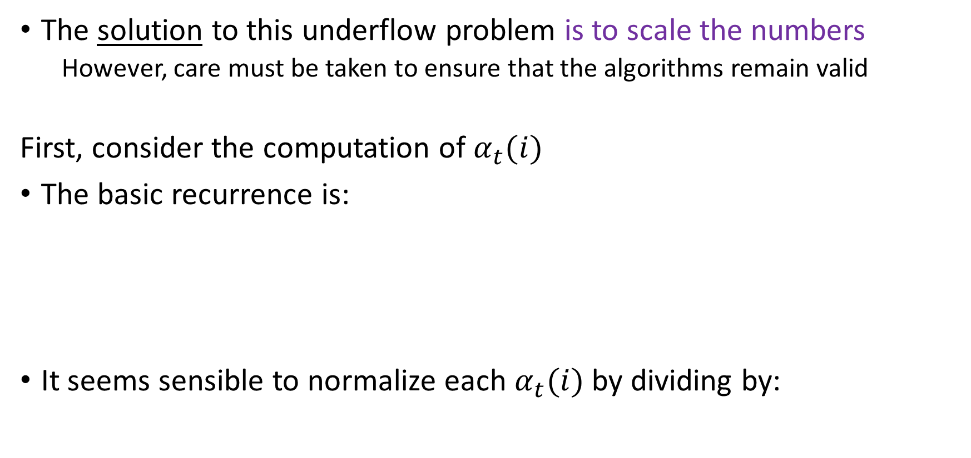
HMM Scaling
The solution to this underflow problem is to scale the numbers
However, care must be taken to ensure that the algorithms remain valid
First, consider the computation of $α_{t}(i)$
The basic recurrence is:
It seems sensible to normalize each $α_{t}(i)$ by dividing by:

Slide 71
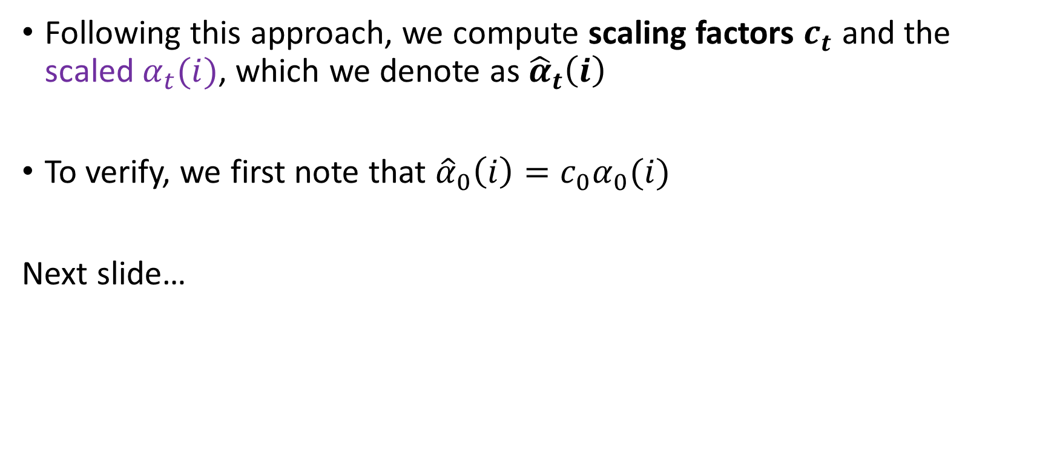
HMM Scaling
Following this approach, we compute scaling factors $c_{t}$ and the scaled $α_{t}(i)$, which we denote as ${\hat{α}}_{t}\left(i\right)$
To verify, we first note that ${\hat{α}}_{0}\left(i\right)=c_{0}α_{0}(i)$
Next slide…

Slide 72

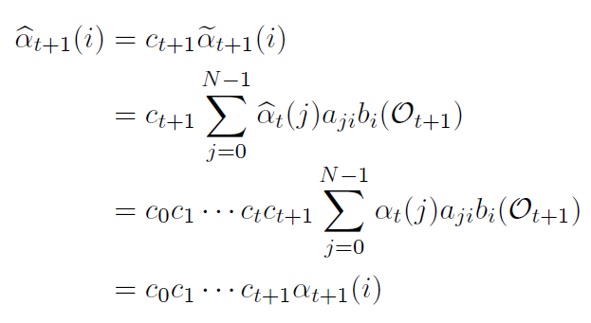
Now suppose that for some t we have:
Then:
And hence holds, by induction, for all t

Slide 73
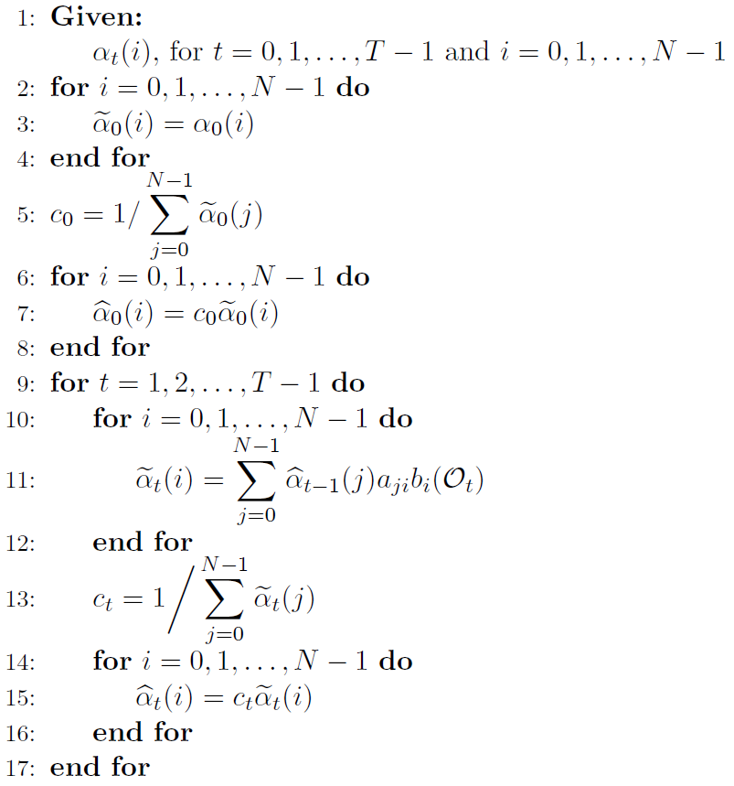
Notes:
We compute the scaled alfa t value

Slide 74
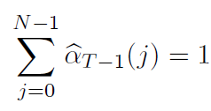


Note that (obviously):
Also, remembering that:
We have:
Notes:
We compute the scaled alfa t value

Slide 75



Combining these results, we obtain:
It follows that we can compute the log of $P\left(𝒪 | λ\right)$ directly from the scaling factors $c_{t}$ as:
Just “logging” the two sides of the equation

Slide 76

Combining these results, we obtain:
It follows that we can compute the log of $P\left(𝒪 | λ\right)$ directly from the scaling factors $c_{t}$ as:
Just “logging” the two sides of the equation

Slide 77

HMM Scaling
Similarly, scale betas as $ctβt(i)$
For re-estimation:
Compute $γt(i,j)$and $γt(i)$using original formulas, but with scaled alphas, betas
This gives us new values for λ = (A,B,π)
“Easy exercise” to show re-estimate is exact when scaled alphas and betas used
Also, P(O|λ) cancels from formula
Use log P(O|λ) = -Σ log(c_{j}) to decide if iterate improves

Slide 78
All Together Now
Here we see the complete pseudo code for Solution 3
Given: (O₀,O₁,…,O_{T-1}) and N and M
Initialize: λ = (A,B,π)
A is NxN, B is NxM and π is 1xN
π_{i} ≈ 1/N, a_{ij} ≈ 1/N, b_{j}(k) ≈ 1/M, each matrix row stochastic, but not uniform
Initialize:
maxIters = max number of re-estimation steps
iters = 0
oldLogProb = -∞
Solution to problem 1
Solution to problem 2
Solution to problem 3

Slide 79
Forward Algorithm
Forward algorithm
With scaling
Solution to problem 1
Solution to problem 2
Solution to problem 3

Slide 80

Backward Algorithm
Backward algorithm or “beta pass”
With scaling
Note: same scaling factor as alphas
Solution to problem 1
Solution to problem 2
Solution to problem 3
NOTE: Solution to problem 2 is NOT shown completely in this pseudo-code

Slide 81
Gammas
Using scaled alphas and betas
Solution to problem 1
Solution to problem 2
Solution to problem 3

Slide 82

Re-Estimation
Again, using scaled gammas
So formulas unchanged
Solution to problem 1
Solution to problem 2
Solution to problem 3

Slide 83
Stopping Criteria
Check that probability increases
In practice, we want:
logProb > oldLogProb + ε
And don’t exceed max iterations
Solution to problem 1
Solution to problem 2
Solution to problem 3

Slide 84
Recap solutions
To problem 1:
To problem 2:
To problem 3:
The full code seen before…

Slide 86
HMM Applications
Applications not chosen because they are the most ingenious or clever, but because they:
Illustrate the basics
Show off the strengths of technique
Easy to understand and appreciate
Academic publications usually favor novel, different, clever, (weird?), …

Slide 87

HMM for English Text Analysis
Marvin the Martian arrives on Earth
Marvin sees written English text
Wants to learn something about it
Martians know HMMs, but not English
So, strip out all non-letters, make all letters lower-case
27 symbols (26 letters, word-space)
Train HMM on long sequence of “symbols”

Slide 88
Training
For first training case, initialize
N = 2 and M = 27
Elements of A and π are all ~1/2
Elements of B are each ~1/27
We’ll use 50,000 symbols for training
After 1st iteration: log P(O|λ) ≈ -165097
After 100th iteration: log P(O|λ) ≈ -137305

Slide 89
The A and π Matrices
Matrices A and π converge to:
What does this tell us?
Started in hidden state 1 (not state 0)
And we know transition probabilities between hidden states
Nothing too interesting here
We don’t (yet) know about hidden states

Slide 90
The B Matrix (Transpose)
What does B matrix tell us?
This is very interesting!
Why???

Slide 91
Conclusion
The B matrix tells Marvin about consonants and vowels
He made no assumption a priori
The training itself “learned” this info
This is the essence of machine learning!
We don’t have to think too much
Machine does all the hard work
Machine “learns” (and so do we)
Notes:
This also illustrates an advantage of HMMs. That is, we can often deduce significant properties of the data from the model itself. Among the techniques we study, HMMs and (to a lesser extent) SVMs have this property. With other machine learning techniques, the models themselves don’t provide much insight. Although the models generated by other machine learning techniques are useful, they are generally not as “human readable” as in an HMM.

Slide 92

Detecting “Undetectable” Malware
Malware is malicious software
Designed to do bad things
Most common form of detection is based on signatures
What is a signature?
Malware writers try to avoid detection
How to avoid signature detection?
One option is to morph/modify code

Slide 93
Metamorphic Malware
Malware that morphs with each new infection is called “metamorphic”
How to write metamorphic malware?
Standalone generator vs malware that “carries its own morphing engine”
How to detect metamorphic malware?
Also not easy, it’s a research topic
Machine learning

Slide 94
Real-World Metamorphism
Examples of metamorphic malware
Why “garbage code” (or “dead code”)?
Why is substitution not used more?

Slide 95
Metamorphic Example
From malware known as NGVCK
3 morphed versions
All do the same thing
Each has different opcode sequence
What can you say about signature(s)?

Slide 96
Experiments
Seed the generator with NGVCK virus
Generated 200 morphed copies
Assemble each morphed asm into exe
Verify that seed virus detected by AV…
…and morphed copies not detected by AV
Disassemble exes, extract opcodes
Train HMMs, using 5-fold cross validation
Score each model vs 40 benign samples

Slide 97
Scatterplot of Results
Ideal separation!
Best-case scenario
Using HMM…
Easy to separate benign from virus
Easy to detect!
Undetectable using signatures…

Slide 98
What’s Going On Here?
Why can we detect this morphed malware using HMMs
But not using signatures?
Signatures are easily disrupted by simple transposition strategy
HMM not affected by transposition
HMM “sees” differences between viruses and benign, in spite of this morphing
Statistical properties are not significantly affected by morphing

Slide 99
Conclusion
Transposition is highly effective anti-signature strategy
But ineffective for machine learning (or statistical-based) analysis
Can virus writer defeat both signatures and machine learning?
Yes, but something more is required.
There is much more to say about this…

